Slide 1
Capstone Project: MuscleHub A/B Test
Help MuscleHub analyze an A/B test and choose a business strategy.

Slide 2
I saw an ad for MuscleHub on BookFace and thought I'd check it out! The people there were suuuuuper friendly and the whole sign-up process took a matter of minutes. I tried to sign up for LiftCity last year, but the fitness test was way too intense. This is my first gym membership EVER, and MuscleHub made me feel welcome.
- Shirley, 22, Williamsburg

Slide 3
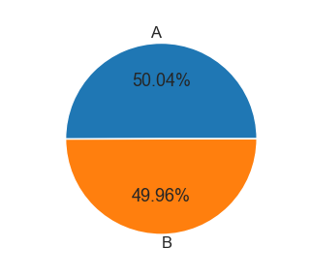
A/B Test
Janet, the manager of MuscleHub, thinks that the fitness test intimidates some prospective members, so she has set up an A/B test.
Visitors will randomly be assigned to one of two groups:
Group A will still be asked to take a fitness test with a personal trainer
Group B will skip the fitness test and proceed directly to the application
Janet’s hypothesis is that visitors assigned to Group B will be more likely to eventually purchase a membership to MuscleHub.

Slide 4
Hypothesis Tests and Visualization
Analyzing data

Slide 5
Hypothesis Tests
Three Hypothesis Tests were ran to test whether there was a significant difference between the two Groups (A and B). Because it was qualitative data and comparing two sets of data, a Chi-Squared Test was most appropriate.
The lower the score, the less chance there is of the “only chance” hypothesis is true
So a low score (usually 0.05 or less) means that there is a real significant difference

Slide 6
0.000964782760
0.4325864605
0.014724114
p-value of significant difference between Groups A and B and whether or not they got an application
p-value of significant difference in membership between Group A and Group B.
p-value of significant difference all people who visit MuscleHub between Group A and Group B.

Slide 7
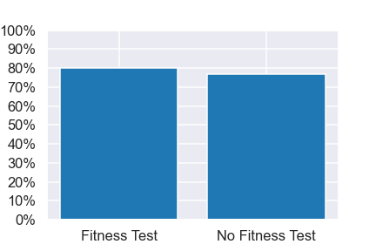
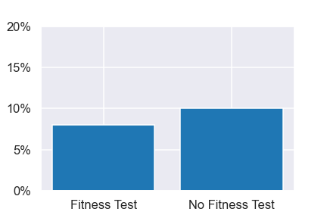
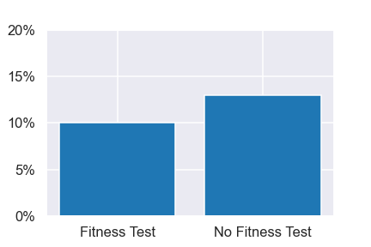

Plots

Slide 8
Based on the qualitative data, there are mixed reports of how effective the fitness test was at welcoming new members. However, overall it seems that the fitness test was a mostly positive experience and a way for visitors to feel welcomed and shown the ropes.
Based on this data plus the data at hand, it seems that giving visitors fitness tests does more harm than good.

Slide 9

Thanks!
Any questions?

